Slide 1
Chapter 2: Displaying Data
BIOL201 FALL 2019
Andrew M. Sackman, Ph.D.

Slide 2
How do we best visualize our data?
An effective graph enables visual comparisons of measurements between groups and exposes relationships between different variables that can be hard to see from looking at raw numbers
Visualizing data is often the first step in statistical analysis

Slide 3
Guidelines for good figures
Show your data
Make patterns easy for readers to see
Depict data honestly with good axes and scales
Make graphical elements clear

Slide 4
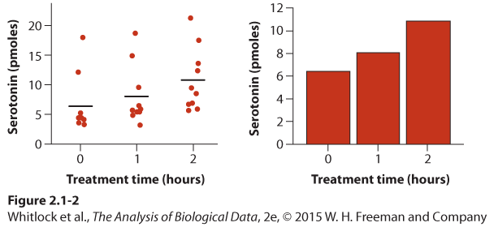
Guidelines for good figures
Show your data
Make patterns easy for readers to see
Depict data honestly with good axes and scales
Make graphical elements clear

Slide 5
Guidelines for good figures
Show your data
Make patterns easy for readers to see
Depict data honestly with good axes and scales
Make graphical elements clear

Slide 6
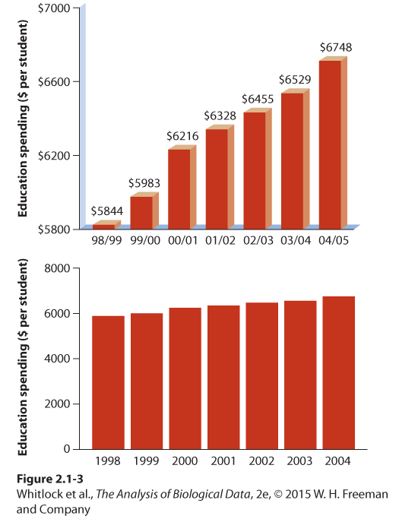
Guidelines for good figures
Show your data
Make patterns easy for readers to see
Depict data honestly with good axes and scales
Make graphical elements clear

Slide 7
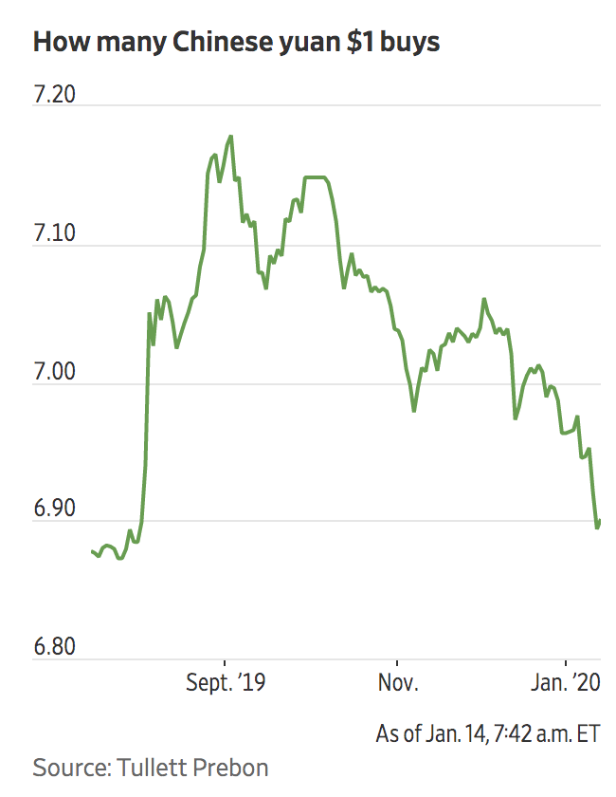
Guidelines for good figures
Show your data
Make patterns easy for readers to see
Depict data honestly with good axes and scales
Make graphical elements clear

Slide 8
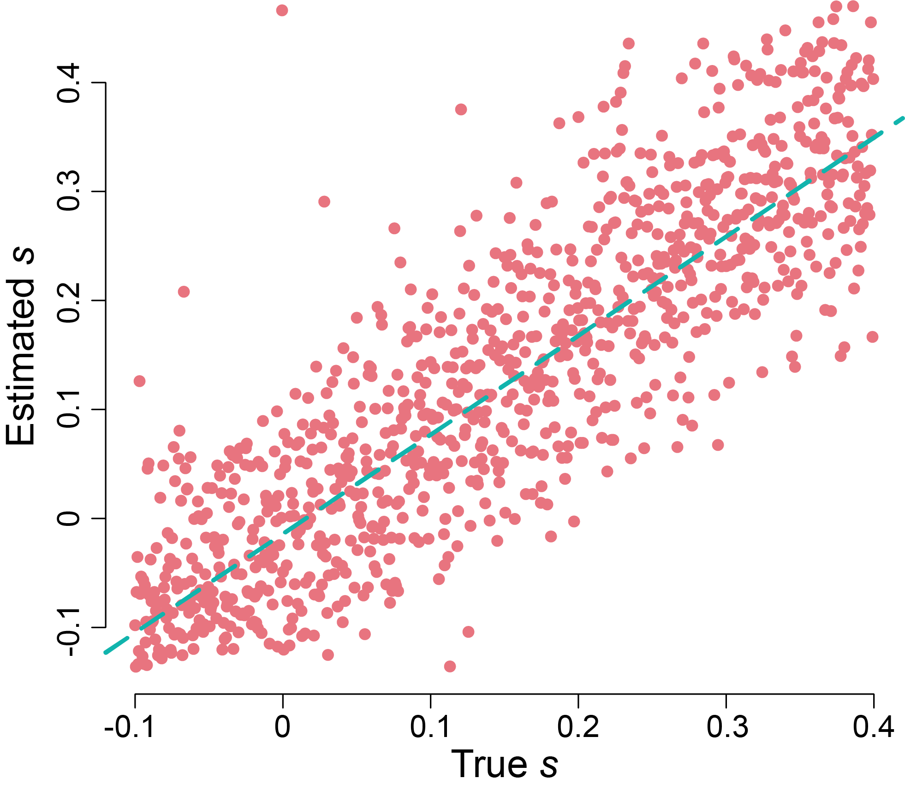
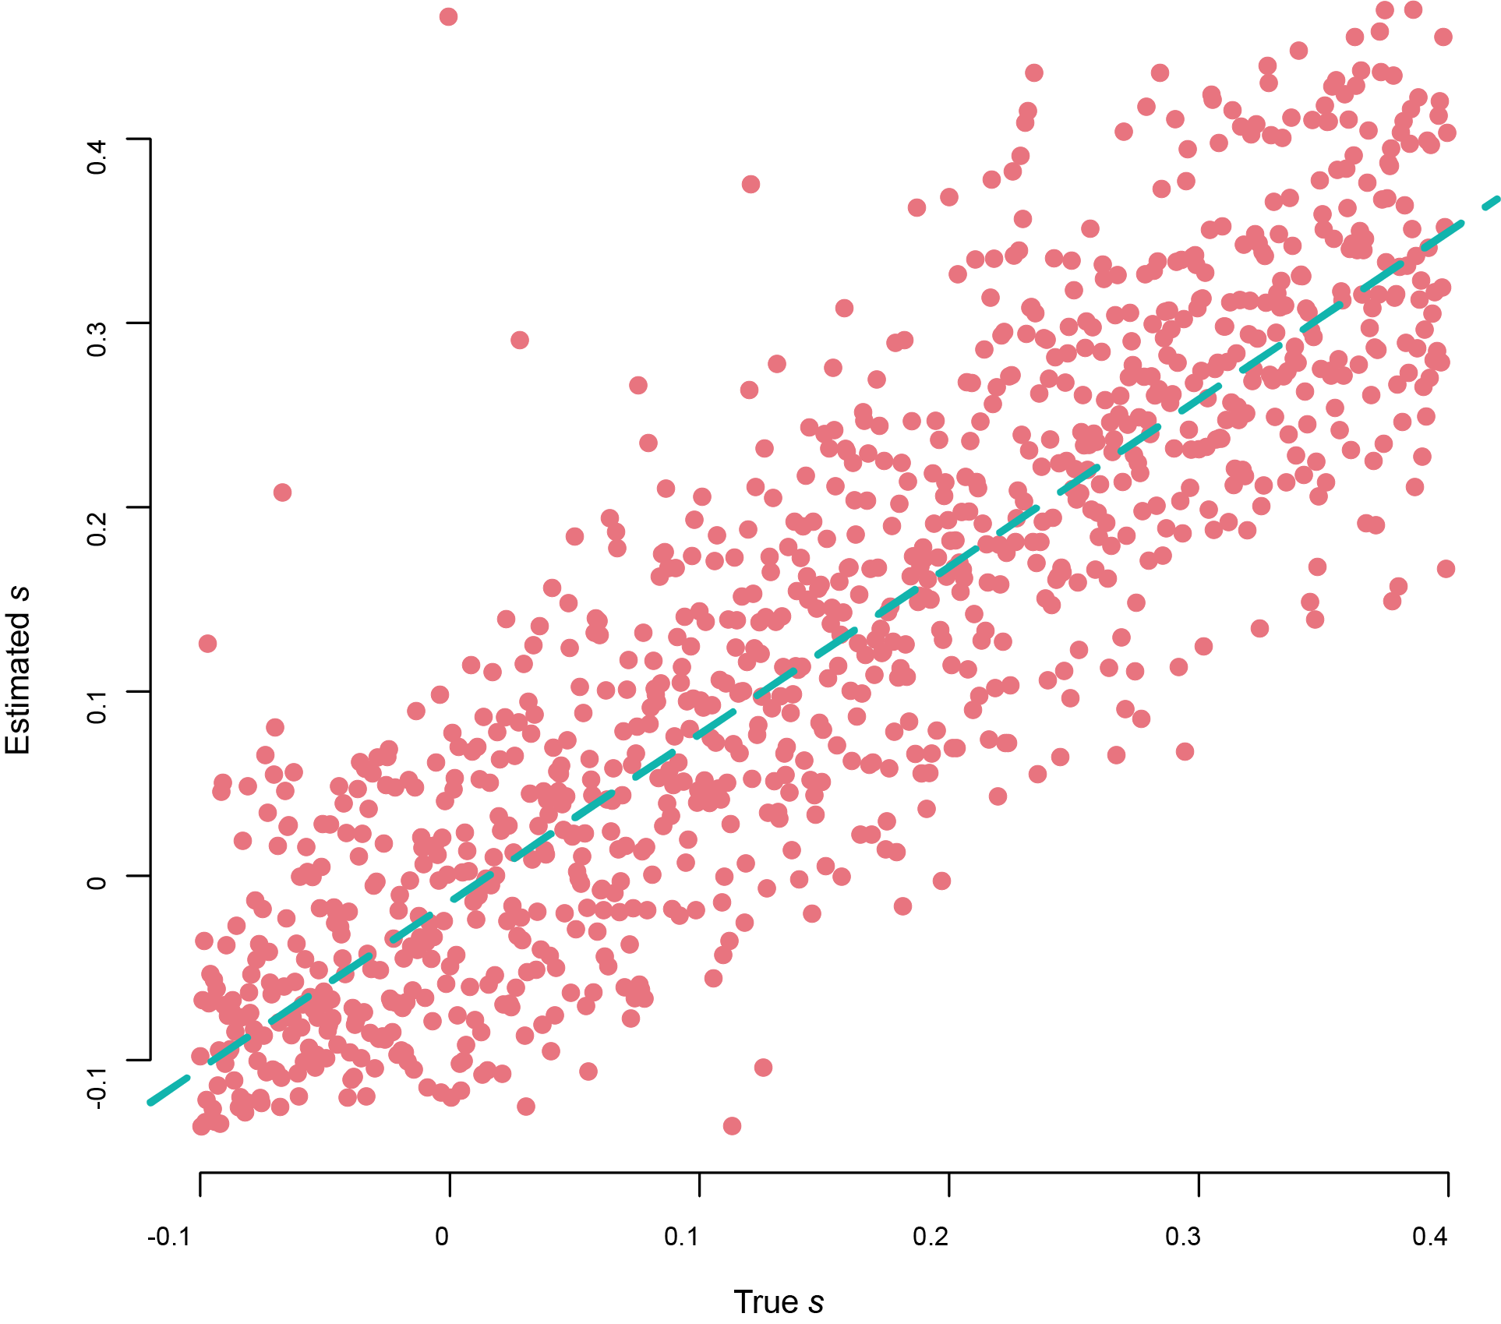
Guidelines for good figures
Show your data
Make patterns easy for readers to see
Depict data honestly with good axes and scales
Make graphical elements clear

Slide 9
Some bad graphs…

Slide 10
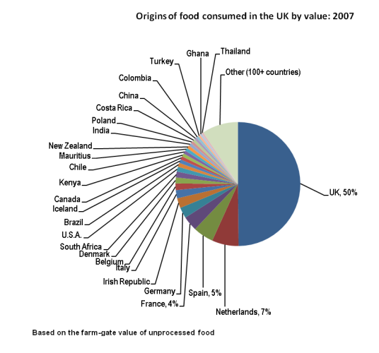

Slide 11
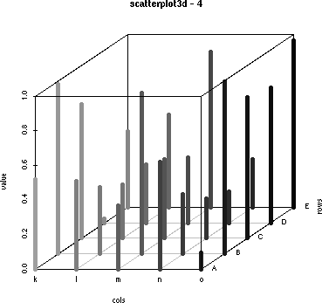

Slide 12
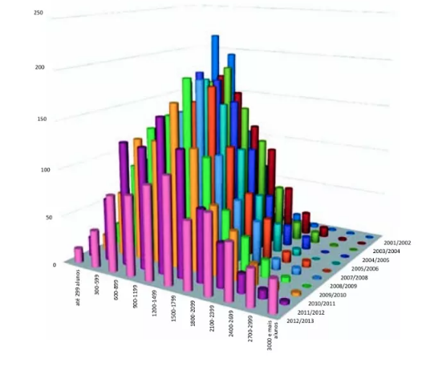

Slide 13
Showing data for a single variable
Recall that the frequency distribution of a variable is the number of observations having each value within the sample
The relative frequency distribution describes the fraction of occurrences of each value of a variable.
A bar graph displays the frequency distribution or relative frequency distribution for a categorical variable.
A pie chart can also be used, but a bar graph is typically easier to read

Slide 14
Frequency table and bar graph activity
To the whiteboard……
Northeast
Midwest
South
West
International
Other

Slide 15
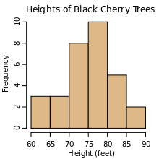
Visualizing numerical variables
The numerical variable equivalent of a bar graph is called a histogram
Ranges are values are grouped into intervals or “bins”
The area of bars is proportional to frequency

Slide 16
Histograms
Histograms give us an idea of the spread of values in a sample and the shape of the frequency distribution and the number of outliers
Notes:
Give examples of what might generate these types of histograms – bell0-shaped – male human height, skewed – number of times visiting Disney world, bimodal – human height across sexes

Slide 17
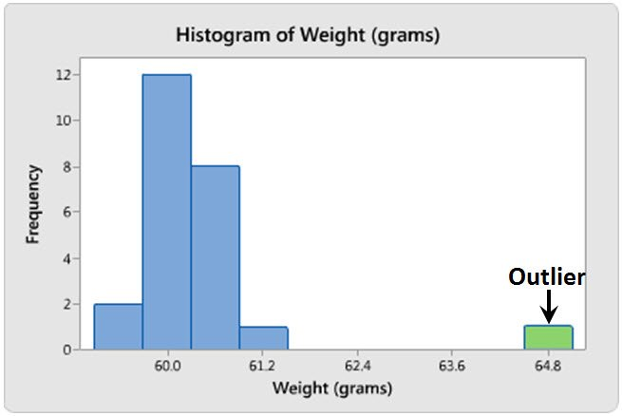
Histograms
Histograms give us an idea of the spread of values in a sample and the shape of the frequency distribution and the number of outliers
Notes:
Give examples of what might generate these types of histograms – bell0-shaped – male human height, skewed – number of times visiting Disney world, bimodal – human height across sexes

Slide 18
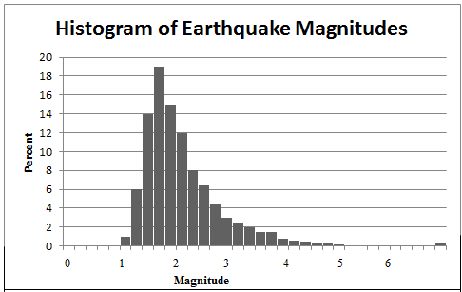

Slide 19
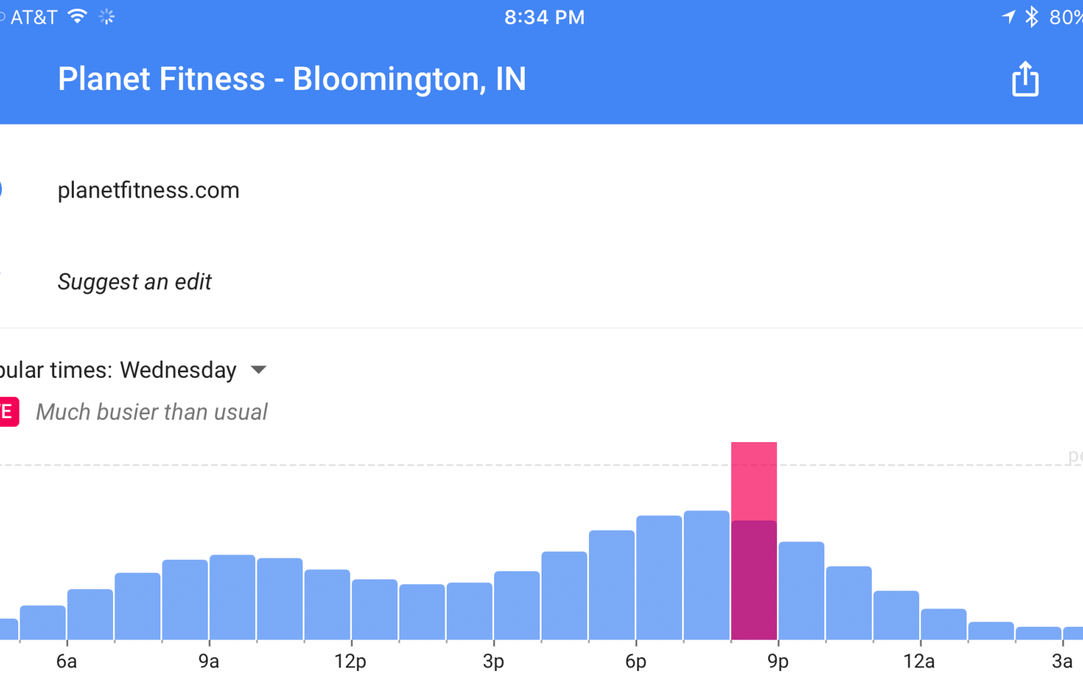

Slide 20
Choosing the number of bins/intervals
The bin size used affects the ease of interpretation and whether all aspects of the data are visible (i.e., multiple peaks)

Slide 21
Histogram activity
To the whiteboard……
Under 4’10”
4’10”-5’2”
5’2”-5’6”
5’6”-5’10”
5’10”-6’2”
Over 6’2”

Slide 22
So what if we want to show associations between two variables? We need to determine what type of variables we are working with…

Slide 23
Two categorical variables
An example:
65 nesting female great tits were divided into two groups
-30 females had two birds stolen, causing them to lay an extra egg
-35 females were left alone
After 14 days, infection of avian malaria was tested

Slide 24
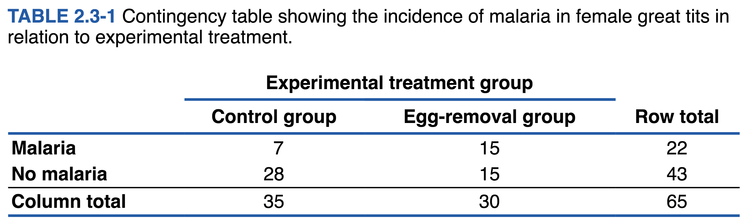
A contingency table gives the frequency of occurrence of all combinations of two or more categorical variables
Explanatory variable goes in the columns, response variable in the rows

Slide 25
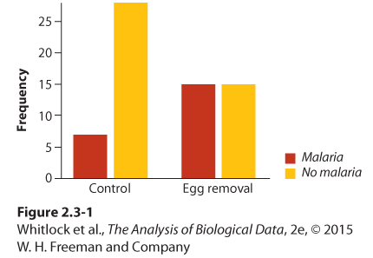
Grouped bar graph
Grouped by explanatory
variable

Slide 26
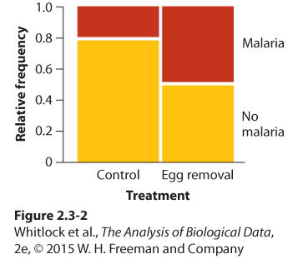
Mosaic plot
Grouped by explanatory variable
Width is proportional to number of observations

Slide 27
Two numerical variables: The scatterplot

Slide 28
One numerical and one categorical variable Strip chart and box plot

Slide 30
Strip chart, box plot, multiple histograms… Which is best? Depends on the data

Slide 31
Showing trends in time and space
Use a line graph when you have time-series data

Slide 32
Showing trends in time and space
Use a map when you have geographic data points

Slide 33
The same principles of making good graphs apply to tables
Show your data, make patterns easy to see

Slide 34
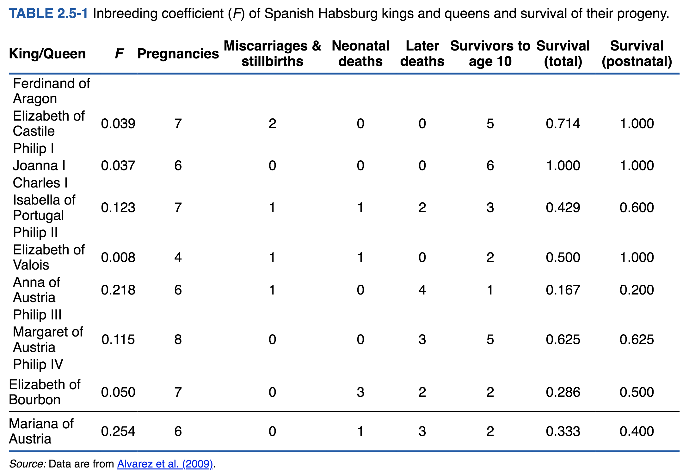

Slide 35
BAD

Slide 36
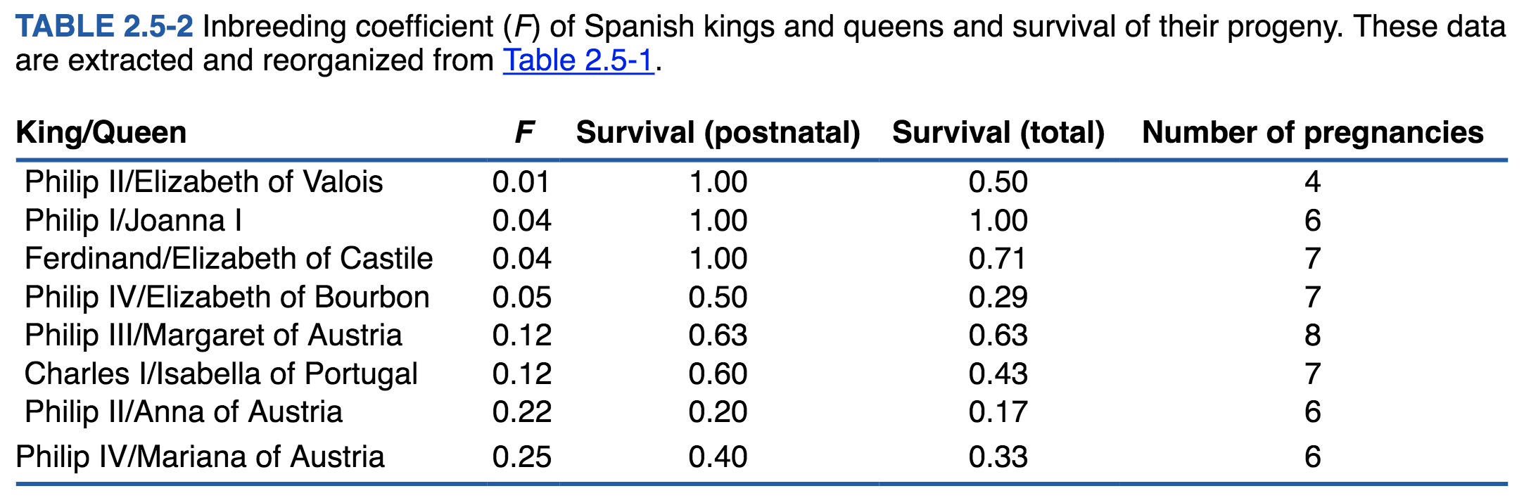
GOOD

Slide 37
Next class
Ch. 3-4

Slide 38
R Tutorial: Importing and visualizing data
BIOL201 FALL 2019
Andrew M. Sackman, Ph.D.

Slide 39
Hopefully you have all installed R and Rstudio, and brought your laptops with you to class
We will be working through a tutorial today in basic importing and plotting of data with R and Rstudio using data from a 1992 paper by Mackowiak et al.
As a reminder, the .csv data sheets for the sample problems in your textbook can all be found at the publisher’s website:
http://whitlockschluter.zoology.ubc.ca/data

